Slide 1
Introduction to Sparse Coding
DEBPRIYA SEAL
DEBSEAL@INDIANA.EDU

Slide 2
Motivation
Many Machine Learning algorithms dependency on:
  Labelled Data
  Good feature
Both of the above dependencies ask for huge human labour.

Slide 3
What is Sparse Coding
Unsupervised Learning Algorithm
Idea is to represent each input vector as a weighted linear combination of small number of “basis vector”
Mathematically, each input feature x  R^{d}
  Represented by basis vector b₁, b₂, … .b_{n}  R^{d}
  And a sparse weight/coefficient vector x  R^{n} s.t. x ≈ ∑_{j} b_{j*}s_{j}
  s_{j} is also referred as activation corresponding to x.
  You would like s to as sparse as possible i.e. have many of the s_{j} to be 0.

Slide 4
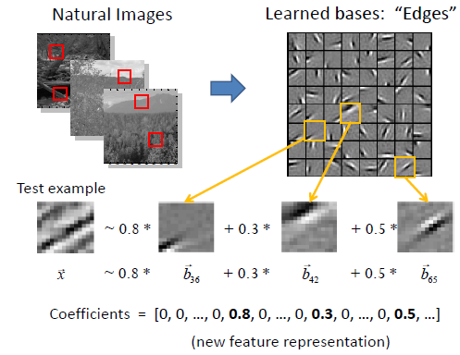
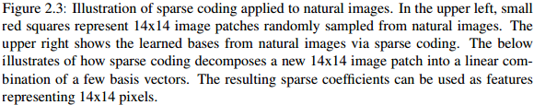
Example
Picture credit to:
UNSUPERVISED FEATURE LEARNING
VIA SPARSE HIERARCHICAL REPRESENTATIONS
http://web.eecs.umich.edu/~honglak/thesis_final.pdf

Slide 5
Pros and Cons
Robust to noise
Less human intervention
Can learn very complex features
Performance being a concern

Slide 6
Thank You ☺

